Slide 1
WEB
Project
Exia A2
Groupe 1

Slide 2



Table of Contents
Introduction
Conception
Visualization

Slide 3
Introduction

Slide 4




Introduction
Conception
Production
Synthesis
Goals of the project :
Develop a website that proposes two services :
Students board events managements
Online sales shop
Differentiation of accounts types : Students, CESI Staff and BDE members

Slide 5
Introduction
Conception
Production
Synthesis
Team presentation
PROJET
WEB
HADJ HABIB
Abdel Jalil
BADANI
Shoukry
KANOUN
Karim

Slide 6



Introduction
Conception
Production
Synthesis
Division of labor
KANOUN Karim : Front end programmer
Jalil HADJ HABIB: Front end programmer
BADANI Shoukry/HADJ HABIB Jalil: Back end programmer

Slide 7
Conception

Slide 8


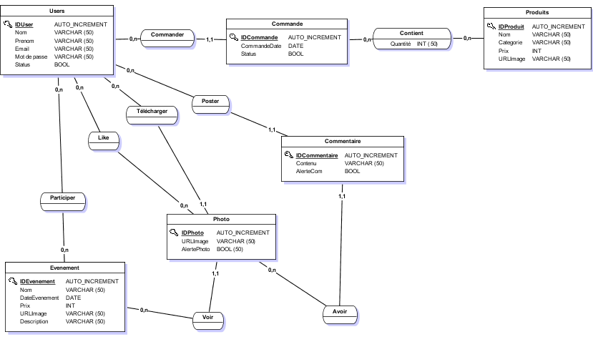
Introduction
Conception
Production
Synthesis
Data-Base - MCD

Slide 9
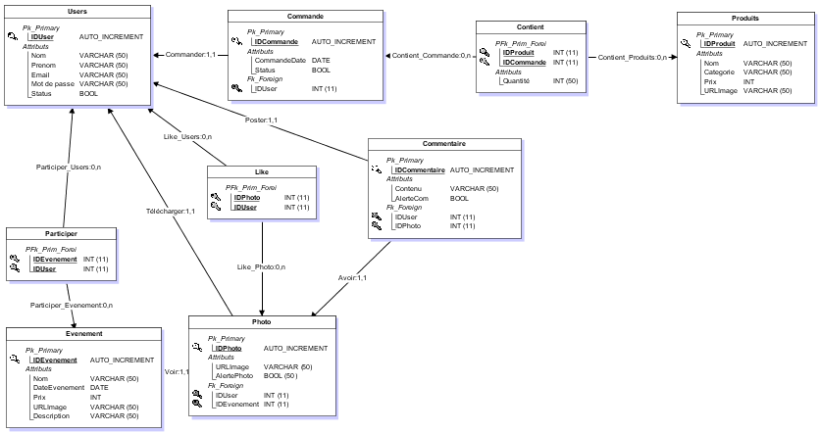
Introduction
Conception
Production
Synthesis
Data-Base - MLD

Slide 10
Visualization

Slide 11
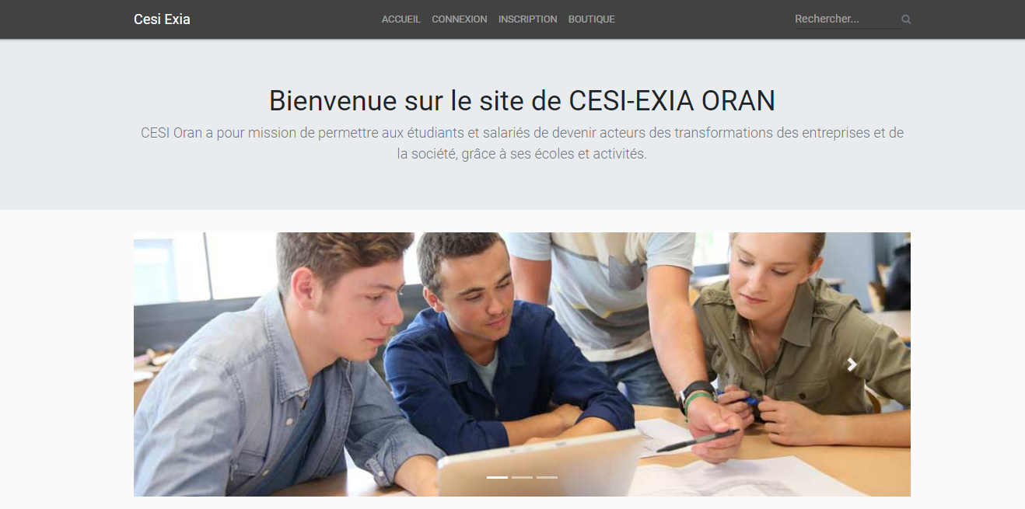
Home

Slide 12
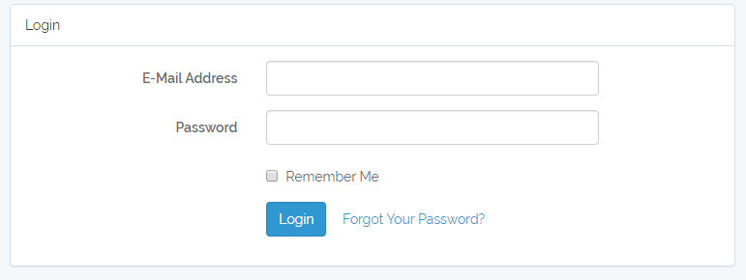
Login

Slide 13
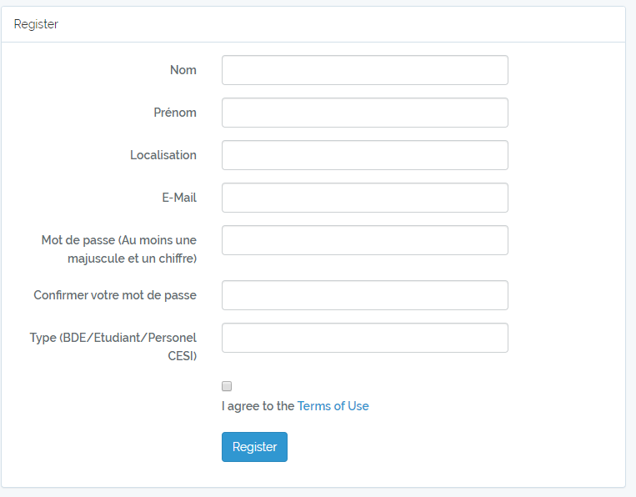
Register

Slide 14
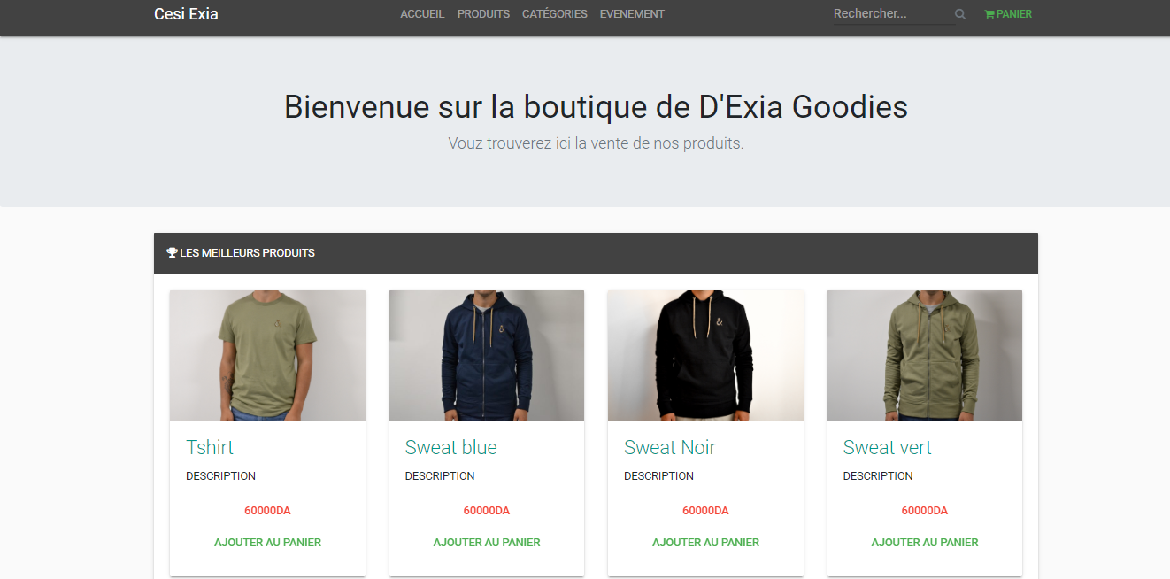
Shop

Slide 15
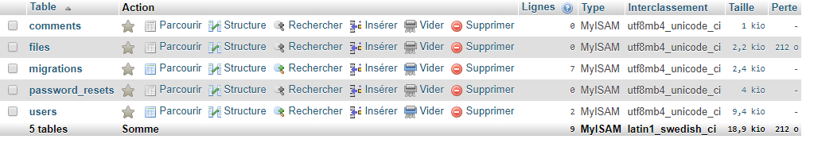
Data Base

Slide 16



Introduction
Conception
Production
Synthesis
Conclusion
Importance of conception
We realized the importance of conception
Imbricated different languages
We learned to use imbricated different languages on a single project
Work together in parallel
We trained ourselves to parallelize the work of everyone
Notes:
We realized the importance of conception
We learned to use imbricated different languages on a single project
We trained ourselves to parallelize the work of everyone

Slide 17

Thank you for your attention

